Slide 1
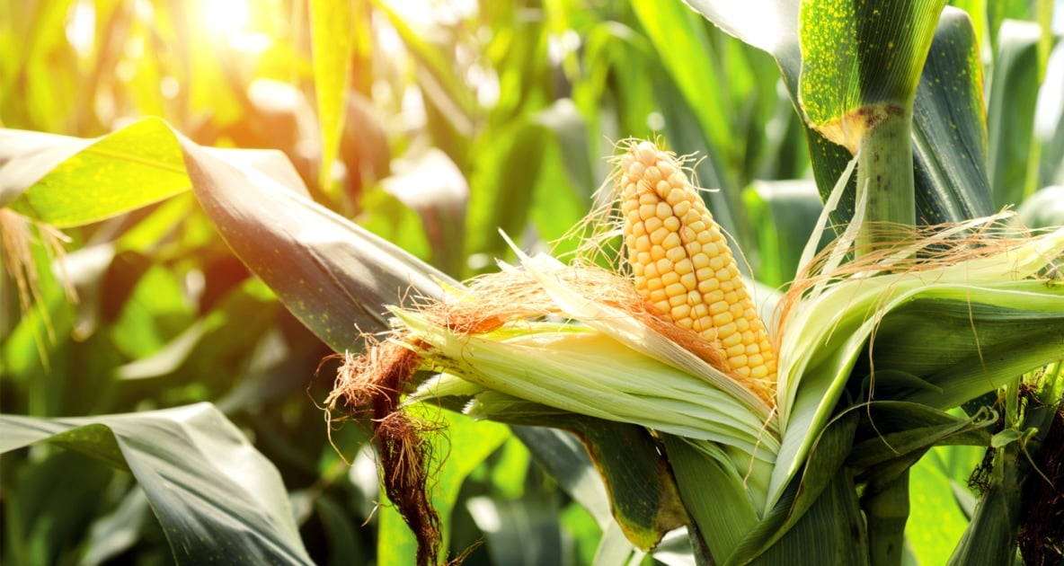
Corn Leaf Disease Classification
A Convolutional Neural Network Analysis
By Clement Chen

Slide 2
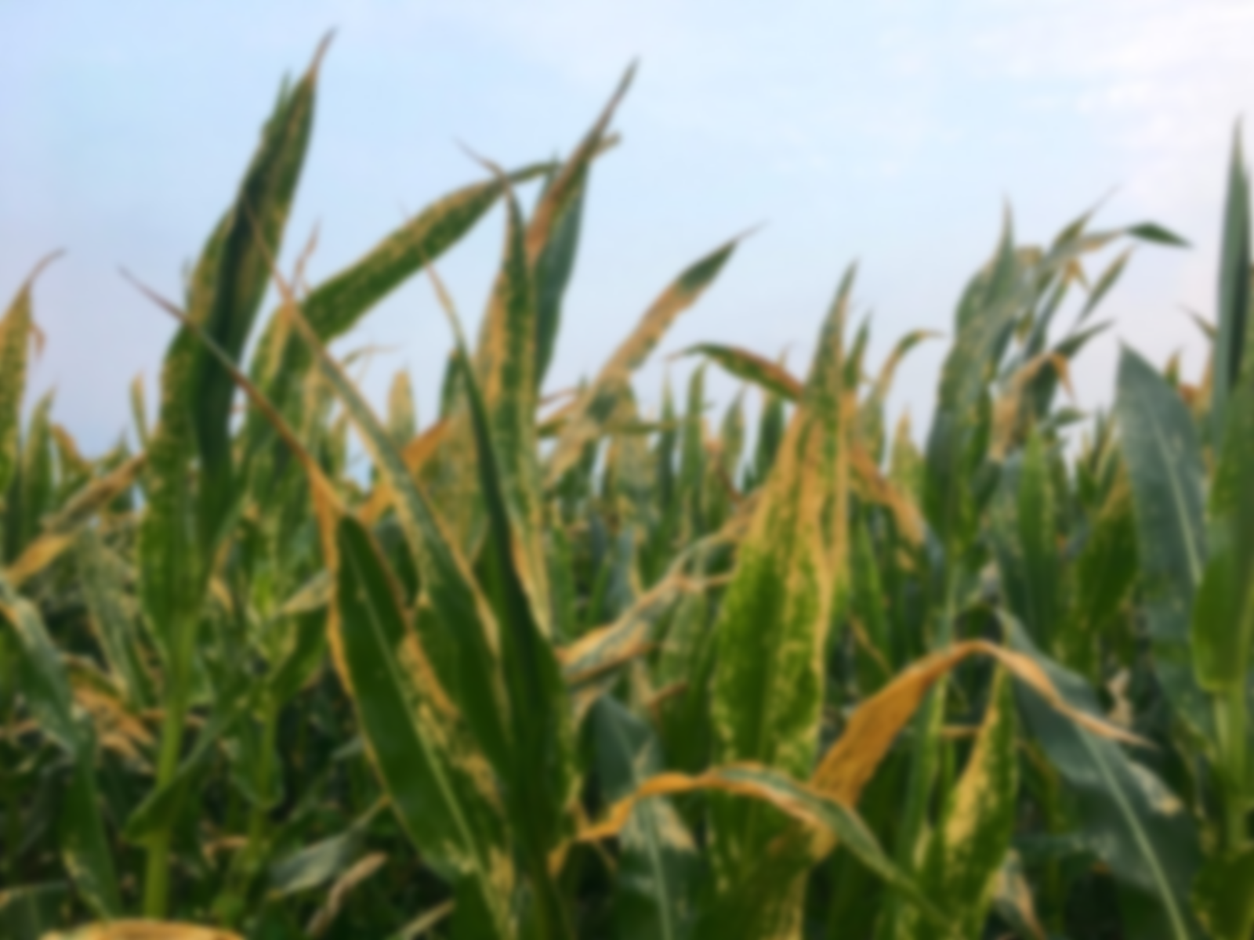
The Problem:
Corn leaf diseases are diverse and prevalent causing millions in losses each year
Current way of identifying corn leaf disease is through slow laboratory testing
Human identification can be prone to errors
Can we develop a machine learning algorithm that can predict corn leaf disease?

Slide 3
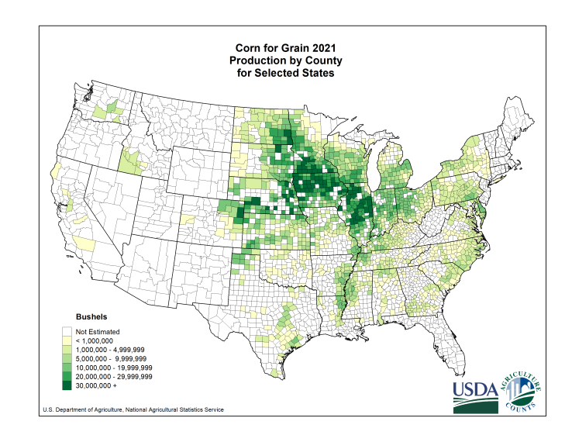




Who Would Find This Analysis Useful?
• Farmers
• Food and Beverage Corporations
• Energy Industry

Slide 4
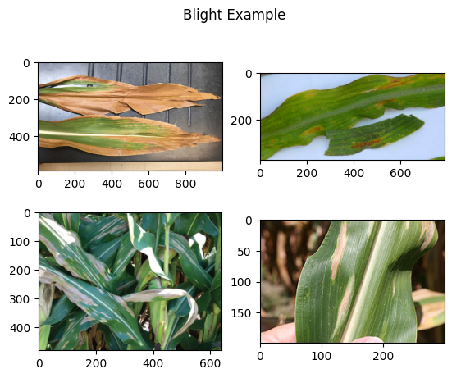
Corn Leaf Dataset
• RGB JPEG images of various dimensions
• Source: PlantDoc and PlantVillage datasets
• 4 classes: Blight, Common Rust, Gray Leaf Spot, and Healthy with 1146,1306, 574, and 1162 instances respectively
• The images have varying backgrounds, lightning, and can part of a leaf or contain multiple plants. Some images are partially occluded.

